Slide 1
AngularJS
Debadyuti Karmakar

Slide 2
What is angular js
AngularJS is a JavaScript framework written in JavaScript.
AngularJS is distributed as a JavaScript file, and can be added to a web page with a script tag

Slide 3
Features
2 way data binding
Templating
Filters
Directives
Etc...

Slide 4
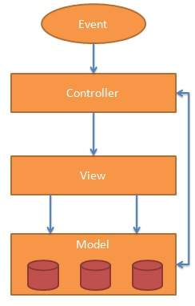
MVC

Slide 5
Model
It is responsible for managing application data.

Slide 6
View
It is responsible for displaying all data or only a portion of data to the users. It also specifies the data in a particular format triggered by the controller's decision to present the data.

Slide 7
Controller
It is responsible to control the relation between models and views. It responds to user input and performs interactions on the data model objects. The controller receives input, validates it, and then performs business operations that modify the state of the data model.

Slide 8
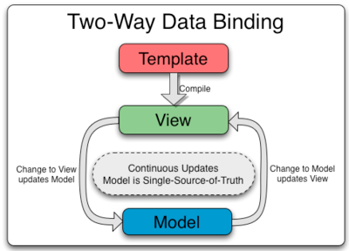
Two way data Binding

Slide 9
AngularJS Expressions
AngularJS binds data to HTML using Expressions.

Slide 10
AngularJS Directives
AngularJS facilitates you to extend HTML with new attributes. These attributes are called directives.
There is a set of built-in directive in AngularJS which offers functionality to your applications. You can also define your own directives.

Slide 11
ng-app: This directive starts an AngularJS Application.
ng-init: This directive initializes application data.
ng-model: This directive defines the model that is variable to be used in AngularJS.
ng-repeat: This directive repeats html elements for each item in a collection.

